Slide 1
RJDemetra tools for statistical production
Frankfurt am Main, April 24, 2024
TSACE-TSAUG Meeting # 10
ALESSANDRO PIOVANI | alessandro.piovani@istat.it
Istat | Directorate For Methodology and Statistical Process Design

Slide 2
Presentation Overview
Pt.1: Tool for specification conversion
JD_JSON format
TRAMO-SEATS (Gomez & Maravall) to RJDemetra (v2) / JDemetra+
Pt.2: RJDemetra Processor: an RJDemetra processing pipeline ready for you
Architecture
Adaptable input interfaces to suit your context

Slide 3
Pt.1: Tool for specification conversion (TRAMO-SEATS to JDemetra+ and RJDemetra)

Slide 4
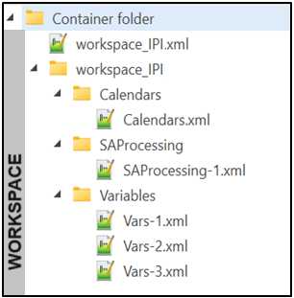
Specifications in JDemetra+ and RJDemetra
JDemetra+ specifications can be retrieved from:
the workspace (XML files into nested folders)
.cfgx files
.RData files (only RJDemetra and rjd3)

Slide 5
Why do we need this?
We found difficulties in handling specifications/workspaces in memorization stage:
limited transparency
workspace XML are verbous
.cfgx or .RData files are not human-readable
our database stores individual time series information, workspaces are designed for multiple time series
one workspace for time-series is not practical for seasonal adjustment in JD+
need a directory storage system (on filesystem or BLOB type field on DB) for workspaces
workspaces store data, specifications, and external regressors together
difficulties for the users in refreshing data (input time series and external regressors).
JD+ providers keep searching for data in the exact same location where they were originally loaded

Slide 6
JD_JSON format
JSON format:
simple and widely recognized format → many libraryes in any languages to handle it
JavaScript types to represent the data → similar and easy to be mapped in R/Java types
"key":value pairs, divided by comma, enclosed in { }; arrays enclosed in [ ]; nested JSONs allowed
easy to read and write for users
Key-values specifications format:
same as c("SA_spec", "TRAMO_SEATS") class attributes from RJDemetra (v2)
little additions
series name → to link specification and data
external regressors info → information to retrieve ext.reg., preferred to values for readability
comments with JavaScript/Java format (// inline, /* … */ multiline)

Slide 7
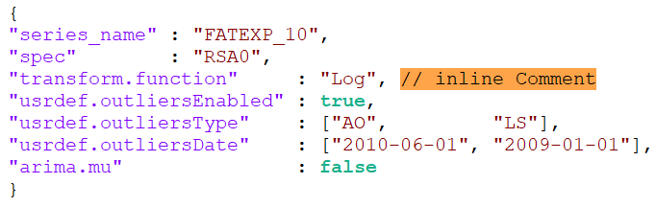
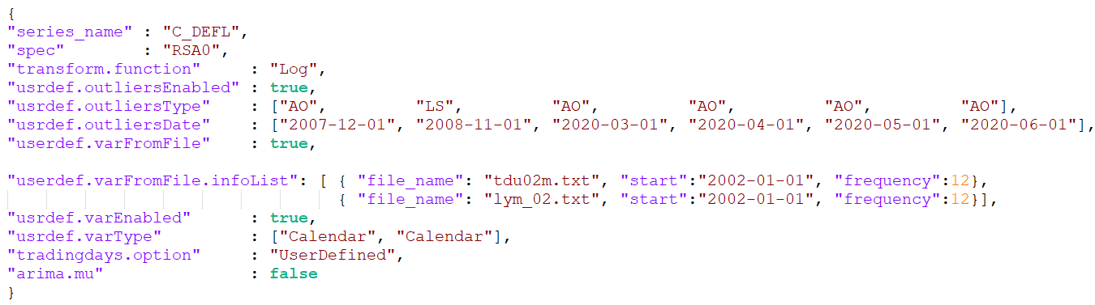
JD_JSON: examples

Slide 8
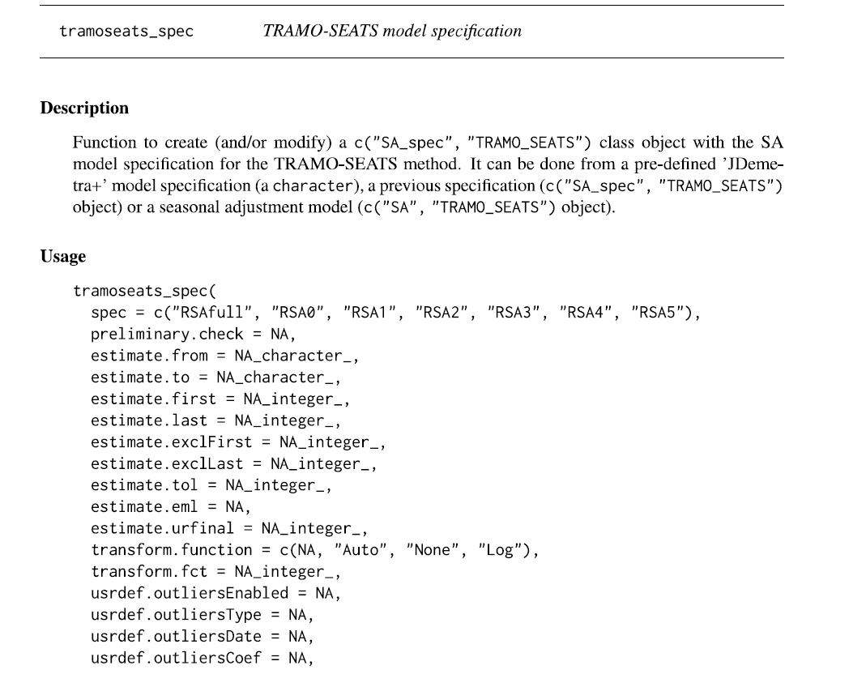
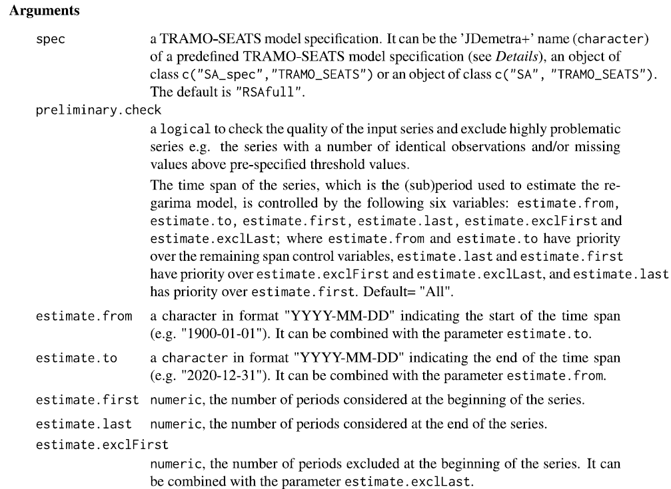
JD_JSON: attributes borrowed from RJDemetra class c("SA_spec", "TRAMO_SEATS")
SOURCE: RJDemetra documentation
…
…

Slide 9
JD_JSON: additional attributes with respect to RJDemetra c("SA_spec", "TRAMO_SEATS")
series_name: a character string indicating the name of the time series. Mandatory, because it allows the matching between specification and rawdata.
userdef.varFromFile: logical indicating whether user-defined variable data will be read from the files specified by userdef.varFromFile.infoList, instead of userdef.var (raw data). If TRUE, the userdef.var field is ignored; if FALSE, userdef.varFromFile.infoList is ignored. Default = FALSE.
userdef.varFromFile.infoList: A vector of JSON elements, each with the attributes:
container: character string representing the name of the file/entity containing the external regressor data;
start: a character string in the format "YYYY-MM-DD" indicating the starting time of the external regressor data;
n_var: number of variables contained in the file (in general =1 or =6 for 6TD setting)

Slide 10
JD_JSON: additional attributes with respect to RJDemetra c("SA_spec", "TRAMO_SEATS")
frequency: numeric. Frequency of the data: E.g. frequency=4 → quarterly data frequency=12 → monthly data.
method: "TS" for TRAMO-SEATS, "X" for X13 (X13 not implemented yet).
intervention_variables: a vector of JSON elements, each one with the attributes:
delta: Numeric;
delta_s: Numeric; • D1DS: boolean if D1DS mode (force delta to 1 and delta_s to 0);
sequences: JSON array: every element has the fields
start: a character string in the format "YYYY-MM-DD"
end: a character string in the format "YYYY-MM-DD"
ramps: a vector of JSON elements, each with the attributes:
start: a character string in the format "YYYY-MM-DD" indicating the starting time of the ramp;
end: a character string in the format "YYYY-MM-DD" indicating the end time of the ramp;
fixed_coef: a numeric or 0 if not set)
EX. of RAMPs: [{"start":"2020-01-01","end":"2020-12-31", "fixed_coef":0},
{"start":"2008-01-01","end":"2009-01-01", "fixed_coef":1}]
EX. of IVs: [{"delta":1,"delta_s":1,"seq":[{"start":"2001-01-01","end": "2001-12-31", D1DS: false }]},
{"delta":0.75,"delta_s":0,"seq":[{"start":"2004-01-01","end":"2005-12-31", D1DS: false}]}]

Slide 11
JD_JSON: additional attributes with respect to RJDemetra c("SA_spec", "TRAMO_SEATS")
easterCoef: fixed coefficient for easter. 0 if not set.

Slide 12
JD_JSON: additional attributes with respect to RJDemetra c("SA_spec", "TRAMO_SEATS")
Series name
External regressors information

Slide 13
JD_JSON: features
Already documented in large part → see tramoseats_spec function in RJDemetra doc.
Easy to read and write for users → no nested objects, apart from userdef.varFromFile.infoList
Easy to be stored into a DB → TEXT/VARCHAR or JSON* field DB types
* some DBMS allow querying fields directly from JSON!
Easy to be handled in R and Java → many libraries available (R: jsonlite/rjson, Java: jackson)
→ easy to be read by RJDemetra
Facilitates synthesis → like specifying arguments to the tramoseats_spec
function → default specification to assign values not
provided by the user (e.g. "RSA0")
→ tools to produce the full version (see slide 13)

Slide 14
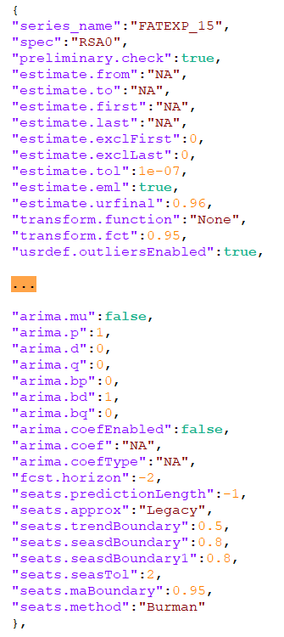
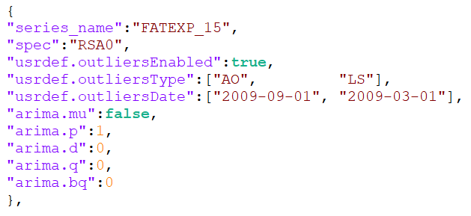
From full to synthetic version and vice versa
JD_JSON.R
from_reduced_to_full_JD_JSON_file(…)
from_full_to_reduced_JD_JSON_file(…)

Slide 15
Workflow & Software
JDemetra GUI
sa-ext-plugin
JD_JSON.R
Now:
TS+
(Gomez & Maravall)
specifications
JD+
Workspace
JD_JSONs
Work in progress:
TS+
(Gomez & Maravall)
specifications
JD_JSON.R
JD_JSONs
JD_JSON.R
JD_JSON_from_virtual_workspace(…)
JD_JSON_to_virtual_workspace(…)
JD_JSON_to_TSplus (…)*
from_reduced_to_full_JD_JSON_obj (…)
JD_JSON_from_materialized_workspace(…)
JD_JSON_to_materialized_workspace(…)
JD_JSON_from_TSplus(…)*
from_full_to_reduced_JD_JSON_obj(…)
interoperability with JD+
* = work in progress

Slide 16
Pt.2: RJDemetra Processor: an RJDemetra processing pipeline ready for you

Slide 17
General overview
JD_JSON format is a component of a larger processing system that is:
R/RJDemetra based • Modular architecture
Object Oriented → S4 Object System for R
This system is the response of our needs of:
a semi-automated production pipeline, interoperable with the JD+ suite
→ workspaces as interoperability tool
use RJDemetra API with many time series without "hardcoding" specifications
→ JD_JSON format
a tool expandable and adaptable to many situations
→ adapting to various input formats/producing custom output
a platform mantainable also by statisticians without expertise in Java
→ building R prototypes converted into Java by IT teams

Slide 18
Building blocks
Responsibility
JD_JSON_file_processor.R
Processing and output of the results
JD_JSON_file_processor (input_data_reader, ext_reg_data_reader, spec_file_name,
output_workspace_dir, series_to_proc_names)
Interaction with workspace and input-output of specifications
JD_JSON.R
c ("Extended_tramoseats_spec")
Interaction with RJDemetra
Extends c("SA_spec", "TRAMOSEATS")
from RJDemetra
Attributes
Constructor(…)
to_JD_JSON(…)
from_JD_JSON(…)
to_named_list(…)
from_named_list(…)
to_sa_spec(…)
from_sa_spec(…)
to_tramoseats_spec_args(…)
DATA_READERS
Acquisition of the input data
c ("Data_reader") c ("Data_reader_ext_reg")

Slide 19
Full JDProcessor Stack + possible extensions(*)
Notation: when a block lies on top of another, it means that it uses (or could use) it. → dependencies description
Orchestrator (User's R script)
JD_JSON_file_processor
Workspace_manager
Reports
JD_JSON
Data_readers
Extended_
tramoseats_spec
Extended_
X13_spec*
R+RJDemetra/rjd3*
R
R
Java

Slide 20




Full JDProcessor Stack + possible extensions(*)
Rjdverse packages involved: RJDemetra, rjd3providers, rjdworkspace, rjdmarkdown, rjdqa
Orchestrator (User's R script)
Reports
R
R
Java

Slide 21
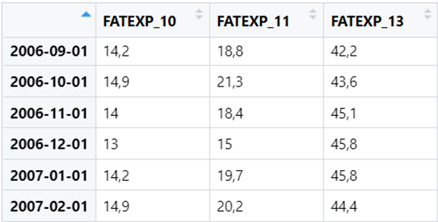
Adapt to your environment through PROVIDER interfaces
To utilize JDProcessor in your environment, simply implement the Provider and Provider_ext_reg interfaces to read your data and external regressors.
flexible input, strict rules for the output
e.g. Provider_csv, Provider_txt, Provider_jdbc
Then, pass the Providers to the processor.
Provider:
Constructor's arguments:
input_source: "ANY"
read_data(…) method:
output: mts (multivariate time series) obj., with time series names and dates
no specific input (…)

Slide 22
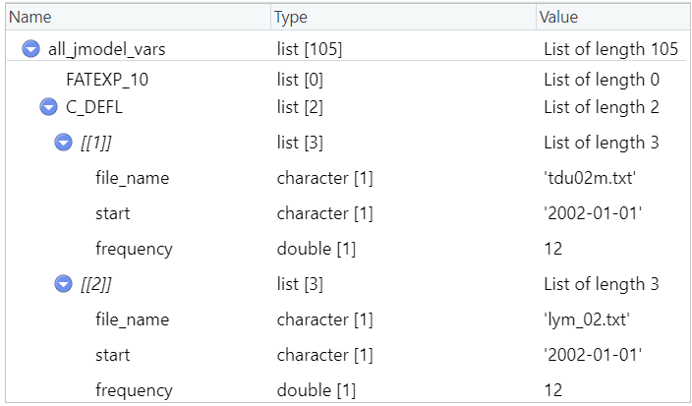
PROVIDER_EXT_REG interface
Provider_ext_reg:
Constructor: input_source (type : "ANY")
read_ext_reg_data (var_info=NULL, time_series_info=NULL, … ):
var_info = list with filename, start_date and frequency
time_series_info = series_name,
output: ts (time series) object
read_ext_reg_info (var_info_container, …):
e.g. var_info_container = ext_reg_files_folder
output: list of ext_var_info for each ts →
how to read data from var. info.
how to produce var. info. (metadata)

Slide 23
Adapt the processor with your Data Readers
Input_ext_reg
CSV
Data_reader_ext_reg_CSV
TXT
Data_reader_ext_reg_TXT
JD_JSON_file_processor
workspace
Data_reader_ext_reg_ws
Ext_reg_data_reader
Custom
Data_reader_ext_reg_CUSTOM
Input_data_reader
Input_data
CSV
Data_reader_CSV
TXT
Data_reader_TXT
Data_reader_ext_reg interface
Custom
Data_reader_CUSTOM
Data_reader interface

Slide 24
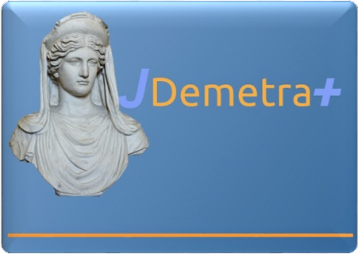

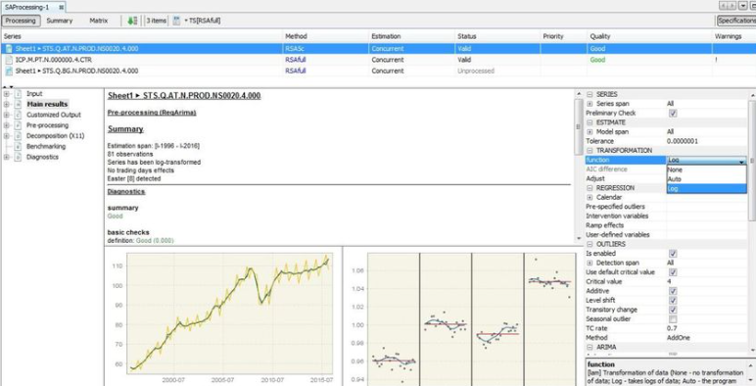

Interoperability with JDemetra+ (GUI, Cruncher, …) through Workspace
JD+
output
workspace
JD_JSON_to_mat._
workspace(…)
TRAMO-SEATS specifications
JD_JSON
specifications
JD_JSON_to_
materialized_
workspace(…)
RJDemetra/R output
JD_JSON_from_
TRAMO_SEATS(…)
RJDemetra_
_processor
workspace
JD_JSON_to_
virtual_
workspace(…)
JD_JSON_from_
workspace(…)

Slide 25
Example of use: orchestrator.R
input_workspace_directory <- "C:\\Workspace-dir\\WS-FAT.xml" #Built with sa_ext plugin
input_data_file_name <- "C:\\SITIC-FAT\\raw_data.csv"
regr_directory <- "C:\\SITIC-FAT\\TS_regr" #Folder with external regressors
spec_file_name <- "C:\\JD_JSON_specifications.txt"
diff <- TRUE # Reduced JSON if diff=TRUE, Full JD_JSON format otherwise
################################# Operational flow ###################################
input_data_provider <- Provider_csv_istat_format(input_data_file_name)
ext_reg_input_provider <- Provider_ext_reg_tsplus(regr_directory)
JD_JSON_from_materialized_workspace(input_workspace_directory, ext_reg_input_provider,
JSON_file_name = spec_file_name, diff)
models <- JD_JSON_file_processor(input_data_provider, ext_reg_input_provider,
spec_file_name, "output_workspace_container")#RJDemetra models
from_reduced_to_full_JD_JSON_file(spec_file_name, "JD_JSON_specifications_full.txt")

Slide 26
Future developments
X13 integration
Developing some default input providers
Creating a rjd3-based version instead of RJDemetra
Production of output formatting components
Enhancing code performance by using RJDemetra functions that operate directly on Java objects rather than R ones
Add other custom fields to JD_JSON ("Keep_ARIMA_coefficients_fixed", …) and relative functionalities in the processor
Addition of detailed error messages
Additional testing

Slide 27
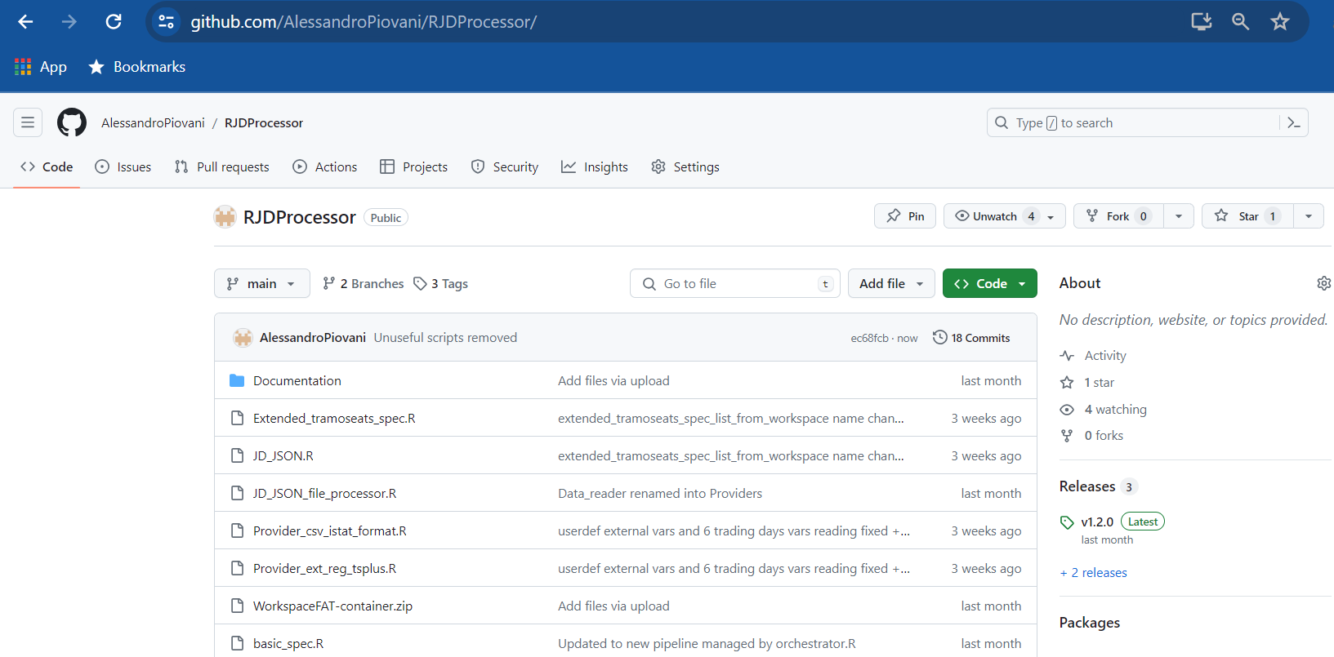
Source code
Source code is available on GitHub:
https://github.com/AlessandroPiovani/RJDProcessor
For information contact me at:
alessandro.piovani@istat.it
alessandro.piovani13@gmail.com

Slide 28
Thanks for your attention!
ALESSANDRO PIOVANI
alessandro.piovani@istat.it

